Slide 1
Maintaining our health
How can we ensure that we maintain our health?
What additional steps can we take to protect ourselves with the viruses that are materialising?
How can we support the school community to remain healthy?
How can we access work from home?
Notes:
When discussing viruses, please do mention Coronavirus.
There are links to news articles later in this presentation.

Slide 2
Time of year
It is the time of year when we can become ill.
Viruses are much more common in this weather.
Coronavirus is currently in the news

Slide 3
News article 1
News article 2
News article 3
News article 4
Notes:
Please go through relevant articles with your class - News article 1 covers the myths.
There is no need to panic and the measures discussed in this presentation are safety measures to support the whole school community.
News article 4 discusses where the world is for a vaccine.

Slide 4
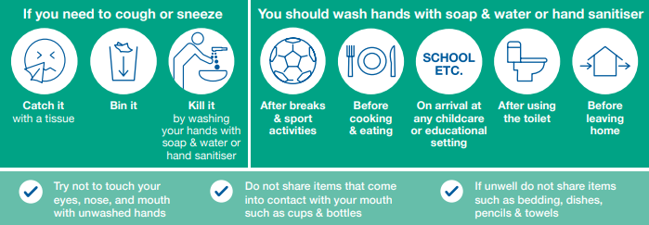
How do we stop viruses spreading?
There are posters in place around the school building informing you of best practice
Notes:
Go through these with students.
These are safety measures for all viruses.

Slide 5
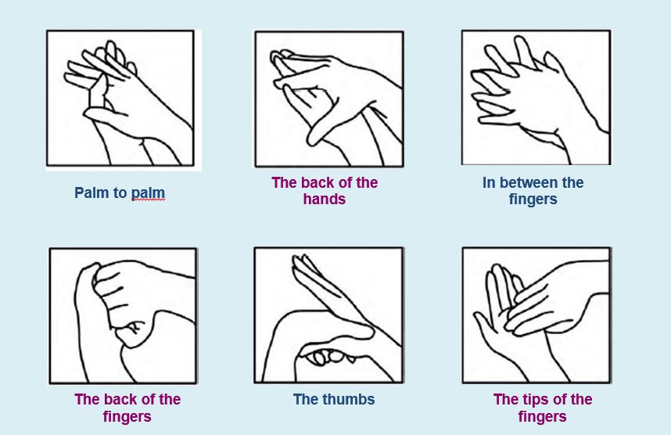
The six steps of hand washing
Use this every time you wash your hands

Slide 6
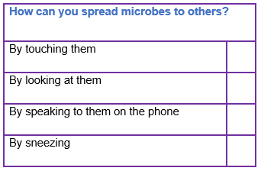
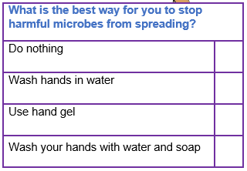
Quick quiz
Notes:
Please ask students to discuss for 30 seconds and then vote with reasons for their answers.
This should enable a discussion.
Microbes are spread by touching or sneezing.
Best way to prevent this is to use hand gel, wash hands with warm water and soap.

Slide 7
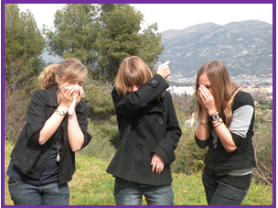
Transfer of Infection - Respiratory hygiene
Respiratory hygiene
What are the advantages and disadvantages of each method of preventing microbes from spreading in:
Your daily life
Reducing the spread of infection
Notes:
Watch the Youtube clip first.
1. This activity can be carried out either individually, in small groups or as a class discussion.
2. Three school friends, Sara, Elisa and Chloe, have all caught a cold and are coughing a lot! As you can see on the picture below, each student has adopted a different way of covering their coughs and sneezes.
3. Ask students to discuss the advantages and disadvantages of each method in the context of
a. Their daily life
b. Reducing the spread of infection

Slide 8
What do you do if you feel unwell?
Follow the hygiene procedures discussed here today.
If you feel that you have a fever whilst in school please inform a member of staff so you can be directed to first aid.
If you have a “new, continuous” cough or high temperature stay at home for seven days.
If it is serious, please contact your GP or 111. 999 should be contacted in an emergency.
If you are vomiting, you need to stay at home until 24 hours after this has stopped.

Slide 9
What do you do if you feel unwell and you cannot come to School?
How will I access my school work?
Teachers have been working very hard on developing an online platform using Microsoft Teams
We as a school are uploading resources for all classes, you will be able to access these from home
YOU will need to know your username and password in order to log in
If you do not know your username or password ASK your form tutor to provide you with this

