Slide 1
Year 10 Subject Choices 2023
We are providing pupils with information, advice and guidance on the full suite of subjects across the school and SRC.
Please note that due to resourcing and timetable restrictions all courses may not be available.

Slide 2


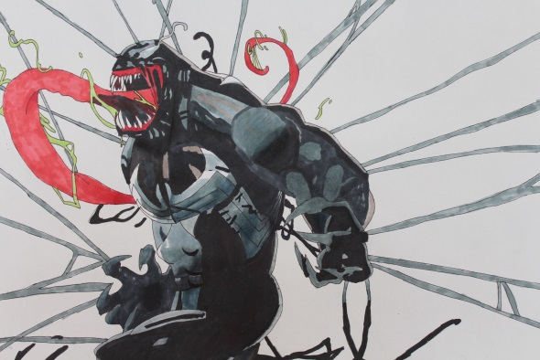
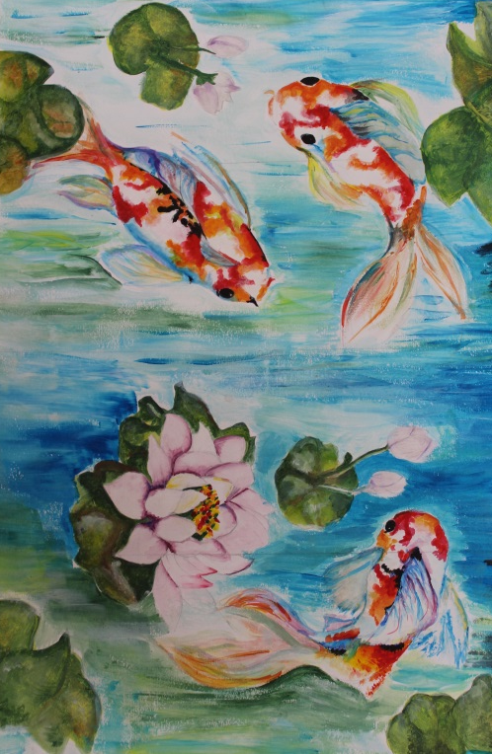



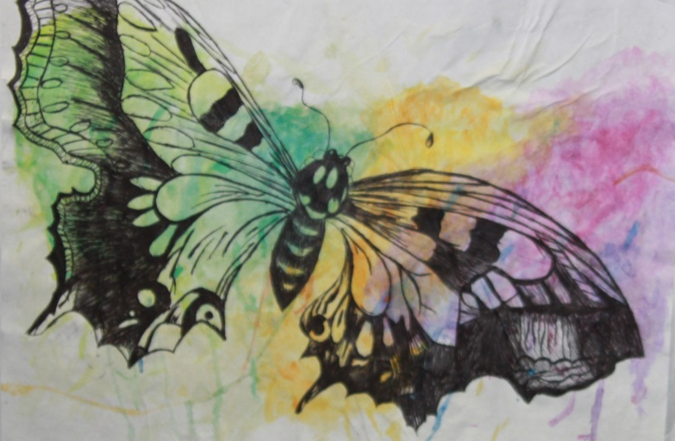
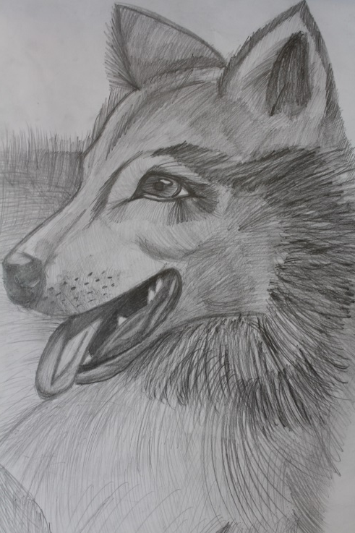

GCSE art and design is a coursework based subject. You will explore the visual language and learn to communicate through images. You will research a wide variety of artists and create 2 final pieces throughout the two year course. GCSE art and design is a really busy course and is very rewarding with an exhibition at the end of year 12.
Present
ideas
Record
Develop ideas
Experiment
creative
Explore materials
confident

Slide 3
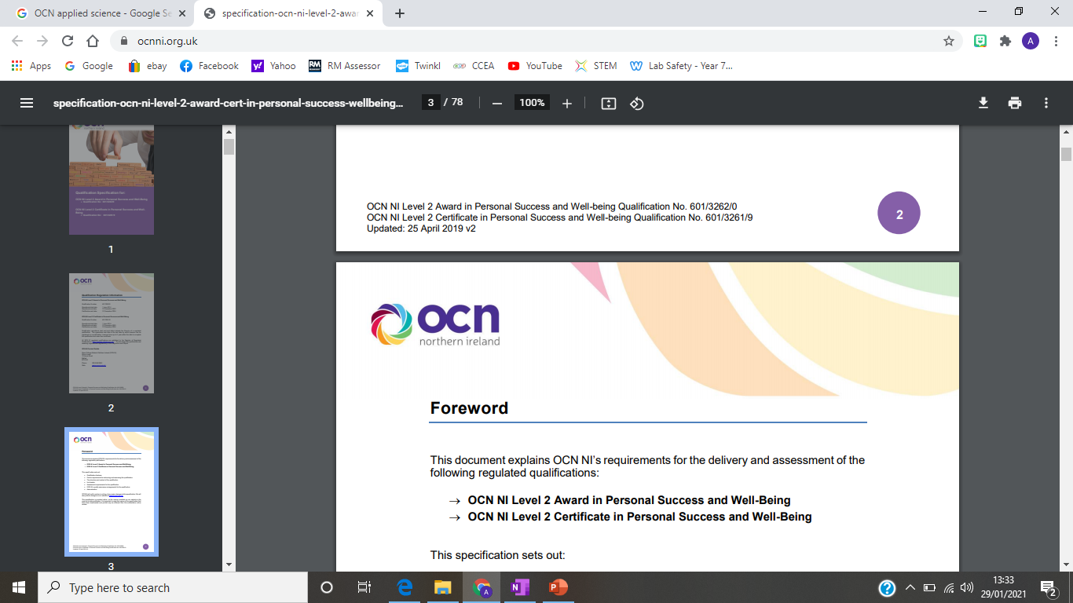



Level 2 Applied Science
Assessment
Portfolio of evidence
Practical demonstration
Research
3 Mandatory Units
Equivalent to GCSE B!
Life Processes
Cellular structure and function
Transport in plants
Genetics and inheritance
Interaction of organisms
Materials and their Chemical Properties
Atomic structure and Bonding
Periodic table
Chemical reactions
Rates of reaction
Physical Processes
Energy transfer
Electricity
Forces and motion
Waves and radiation

Slide 4


Single Award Science
Single Award Science
Unit 1: Biology – external exam worth 25%
Topics include - Cells Microscopy, Food and diet, Chromosomes and genes, Co-ordination and control, Reproductive system, Variation and adaptation, Disease and body defences and Ecological relationships
Unit 2: Chemistry – external exam worth 25%
Topics include - Acids, bases and salts, Acids, bases and salts, Acids, bases and salts, Bonding, Materials, Symbols, formulae and equations, Qualitative analysis, Metals and the reactivity series, Rates of reaction and Rates of reaction
Unit 3: Physics – external exam worth 25%
Topics include - Electrical circuits, Household electricity, Energy, Electricity generation, Waves, Road transport and safety – reducing reliance on fossil fuels, Radioactivity, Earth in space
Practical skills module in 2 booklets – worth 25%
Booklet A - Students carry out two pre-release practical's in Biology, Chemistry and Physics
Booklet B - Students answer compulsory structured questions that include short responses, extended writing and calculations, all set in a practical context for Biology, Chemistry and Physics

Slide 5

Double Award Science
In Year 11 pupils complete 3 Modules – each worth 11%
Biology Unit B1: Cells, Living Processes and Biodiversity
Chemistry Unit C1: Structures, Trends, Chemical Reactions, Quantitative Chemistry and Analysis
Physics Unit P1: Motion, Force, Moments, Energy, Density, Kinetic Theory, Radioactivity, Nuclear Fission and Fusion
In Year 12 pupils complete:
3 final Modules – each worth 14%
Biology Unit B2: Body Systems, Genetics, Microorganisms and Health
Chemistry Unit C2: Further Chemical Reactions, Rates and Equilibrium, Calculations and Organic Chemistry
Physics Unit P2: Waves, Light, Electricity, Magnetism, Electromagnetism and Space Physics
1 Practical skills module in 2 booklets – worth 25%
Booklet A - Students carry out three pre-release practical's in Biology, Chemistry and Physics
Booklet B - Students answer compulsory structured questions that include short responses, extended writing and calculations, all set in a practical context for Biology, Chemistry and Physics

Slide 6



BTEC Business
The Edexcel BTEC Level 2 First Award:
•Is equivalent to one GCSE
•25% is a one-hour online exam
•75% is coursework
•60 hours are spent on compulsory and 60 hours are spent on optional units
The following topics are studied during the BTEC course:
Unit 1: Introducing Business (coursework)
Unit 2: Finance for Business (exam)
Unit 3: Enterprise in the Business World (coursework)
Unit 4: Promoting a Brand (coursework)
Mrs Haire

Slide 7

Child Development
Two Exams = 30% each
(60% of overall GCSE Grade)
Controlled Assessment=
40% of overall GCSE Grade
Topics studied:
Year 11 Parenthood, Pregnancy and the Newborn Baby | Year 12 The Development of a child (0-5 years)
Parenthood and responsibilities Pregnancy Healthy diet and lifestyle in pregnancy Birth Development of the newborn baby Sudden Infant Death Syndrome (SIDS) Choosing clothes and equipment for a baby Breastfeeding vs. Bottle-feeding | Dietary needs of the child Safety in the home and garden Childhood Infectious diseases (meningitis, measles, mumps, rubella, chicken pox) PIES development up to five years old Child care provision and sources of support available

Slide 8

ENGLISH LANGUAGE
LEVEL: GCSE
Unit 1: Writing for Purpose and Audience and Reading to Access Non-fiction and Media Texts (EXAM) 30%
Unit 2: Speaking and Listening (CONTROLLED ASSESSMENT) 20%
Unit 3: Studying Spoken and Written Language (CONTROLLED ASSESSMENT) 20%
Unit 4: Personal or Creative Writing and Reading Literary and Non-fiction Texts (EXAM). 30%

Slide 9


ESOL Skills for Life
(English for Speakers of other Languages)
This qualification is for learners whose first language isn’t English, helping them gain the communication skills needed to progress in the workplace, education and beyond.
Levels available:
Entry Level 1
Entry Level 2
Entry Level 3
Level 1
Level 2
Assessments:
Speaking and Listening
Reading
Writing

Slide 10
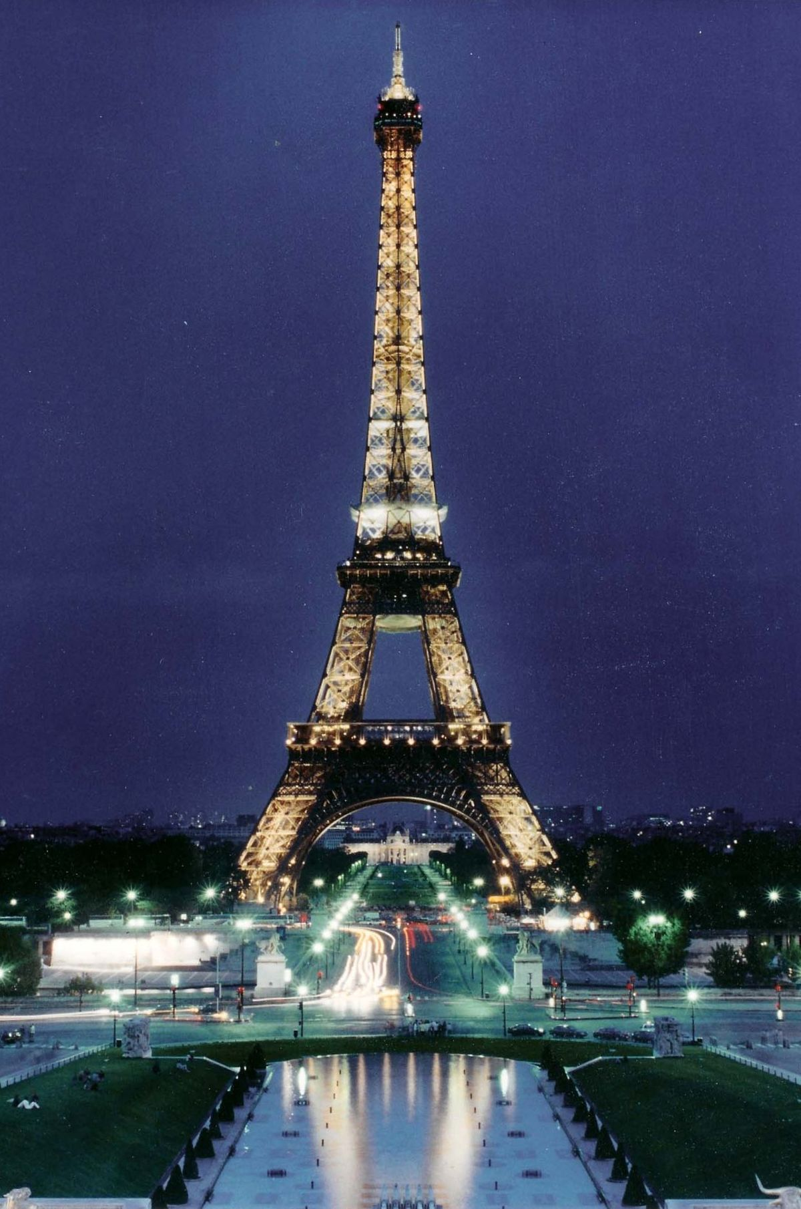
MODERN LANGUAGES-
FRENCH
OCN LEVEL 2 IN MODERN LANGUAGES
In this 2 year course we will collect portfolio evidence in 5 areas that will be assessed through Internal and External Verification
Those areas are:
Speaking Reading
Listening Writing
Intercultural Understanding
This Photo by Unknown author is licensed under CC BY-SA.

Slide 11
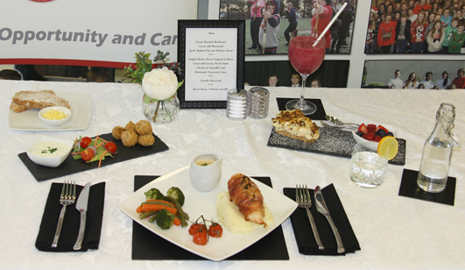
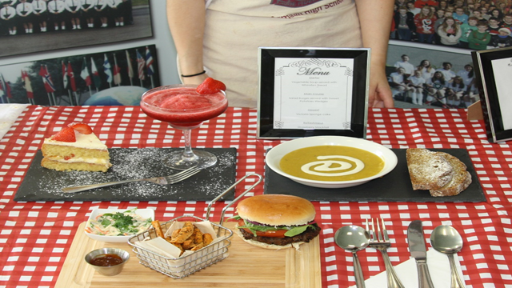
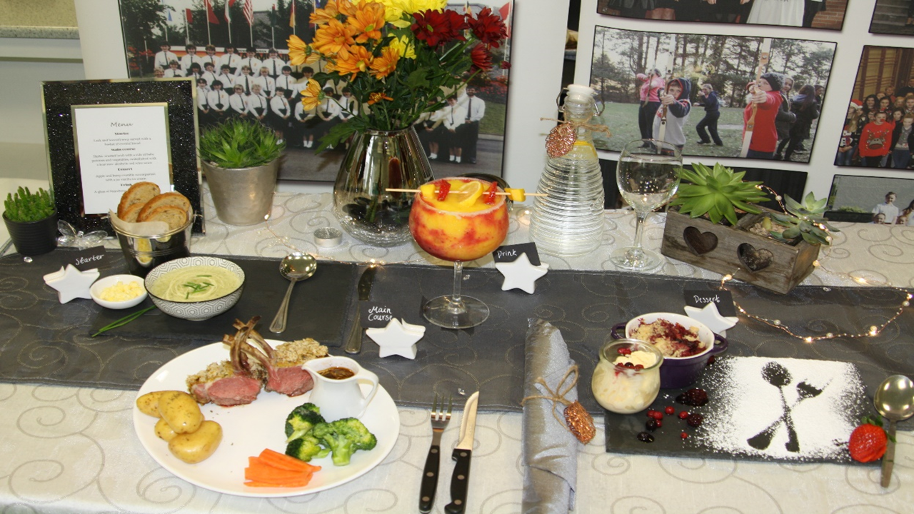
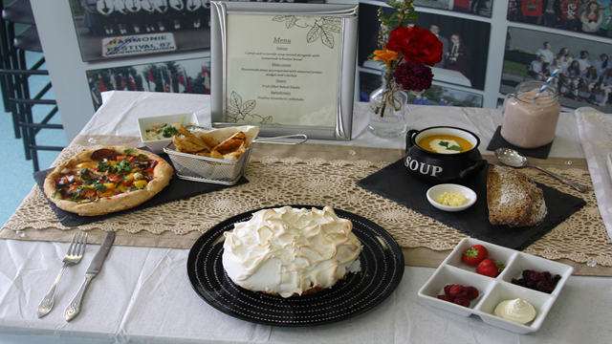
GCSE Home Economics:
Food and Nutrition
1 Written exam paper= 50%
Year 12- 2 hours exam paper
Controlled assessment= 50%
Year 12- 1 piece of controlled assessment (both theory and practical based)
Topics studied:
Year 11 | Year 12
Food Provenance Eatwell Guide Macro/Micro nutrients Creativity in food Nutritional needs throughout the life cycle Dietary Disorders Safe Food | Special Diets Being an Effective Consumer What influences shopping Money Matters Wiser Buyer Consumer Organisation's

Slide 12



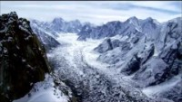
Unit 1: Understanding Our Natural World
River Environments
Coastal Environment's
Our Changing Weather and Climate
The Restless Earth
One hour 30 minute written exam sat in June of Year 11. This exam is worth 40% of the overall GCSE qualification.
GCSE Geography
Want to know why people work where they do?
Waste and Water Management
Tourism
Army /Police
Retailer
Housing /Building Developer
Town and transport planning
Law and Business
Unit 2: Living in Our World
Population and Migration
Changing Urban Areas
Contrasts in World Development
Managing Our Environment
One hour 30 minute written exam sat in June of Year 12. This exam is worth 40% of the overall GCSE qualification.
Click the link to view the subject snapshot
Snapshot_19.pdf (ccea.org.uk)
Unit 3: Fieldwork
This is an external exam based on fieldwork . It is usually a river study carried out on the River Shimna This task is worth 20% of the overall GCSE qualification
Choose Geography

Slide 13

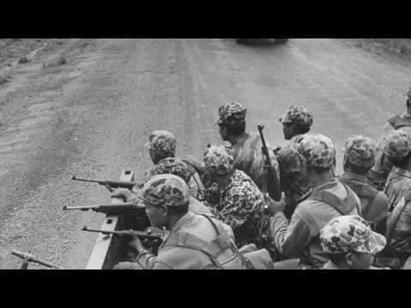

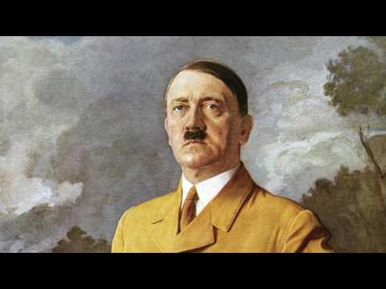
History GCSE
TOPICS STUDIED
INFORMATION
Assessment is by two examination papers, both taken in Year 12
Click on each picture for a link to watch videos on the topics we study
You can get an overview of the course by clicking this link!
You can get access to course material and topics by clicking this link!
The Cold War and the War on Terror
Click on the video on the right for a sample
Northern Ireland and the Troubles – 1968-1998
Click here for a sample video
Germany 1939-1945
Click on the video to the right for a sample

Slide 14

OCN ICT
Assessment is carried out through the process of creating a portfolio of evidence subject to Internal and External Verification and is awarded a pass or a fail. A pass is equivalent to a GCSE grade B.
The following topics are studied during the OCN ICT course:
•Social media
•Email Software
•Word Processing Software
•Presentation Software
•Using the internet
Mrs Haire

Slide 15

BTEC ICT
The Edexcel BTEC Level 2 First Award:
•Is equivalent to one GCSE
•25% is a one-hour online exam
•75% is coursework
•60 hours are spent on compulsory and 60 hours are spent on optional units
The following topics are studied during the BTEC course:
Unit 1: The Online World (exam/compulsory)
Unit 3: A digital Portfolio (coursework/compulsory)
Unit 13: Website Development (coursework/optional)
Mrs Haire

Slide 16

MATHEMATICS
LEVEL: GCSE
TIERS: Foundation or Higher Tier
Each tier is divided into two components: one unit test ( M1, M2, M3 or M4) and one completion test (M6, M7 or M8).
The unit test accounts for 45 % and consists of a calculator paper.
The completion test accounts for 55 % and consists of two papers; a non-calculator paper and a calculator paper.

Slide 17

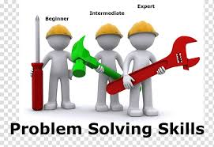
MATHEMATICAL SKILLS
Levels available:
Entry Level 1, Entry Level 2, Entry Level 3
This qualification focuses on developing confidence and ability in mathematics.
Broken down into more bite-size chunks there are a range of unit testing based on individual topics in mathematics rather than an end of year exam comprising of all topics.
These individual unit tests are ‘banked’ during the course of your studies in order to achieve your overall qualification.
Each unit is assessed through an assessment taken under supervised conditions. The assessment is internally assessed and verified and then externally verified.

Slide 18

GCSE MUSIC
Pupils complete three areas of Study:
1) Listening to Pieces from Film Music to Pop Music, assessed by a listening paper.
Performance : pupils play a piece on their own (solo) and a piece with one or two others (ensemble), assessed via recording at the moment.
3) Composition: Pupils make up their own tune using computer software in school. This is assessed by CCEA, the exam board.
The three strands equate to one GCSE.
Pupils have more choice in terms of performance- you can play to your strengths!

Slide 19
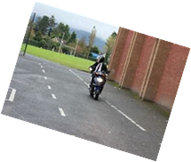
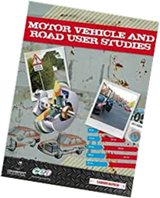
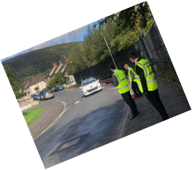


GCSE Motor Vehicle and Road User Studies has three units:
Unit 1: Motor Vehicle and Road User Theory – External written examination 50%
Unit 2: Investigative Study 25%
Unit 3: Practical Riding Activity 25%

Slide 21
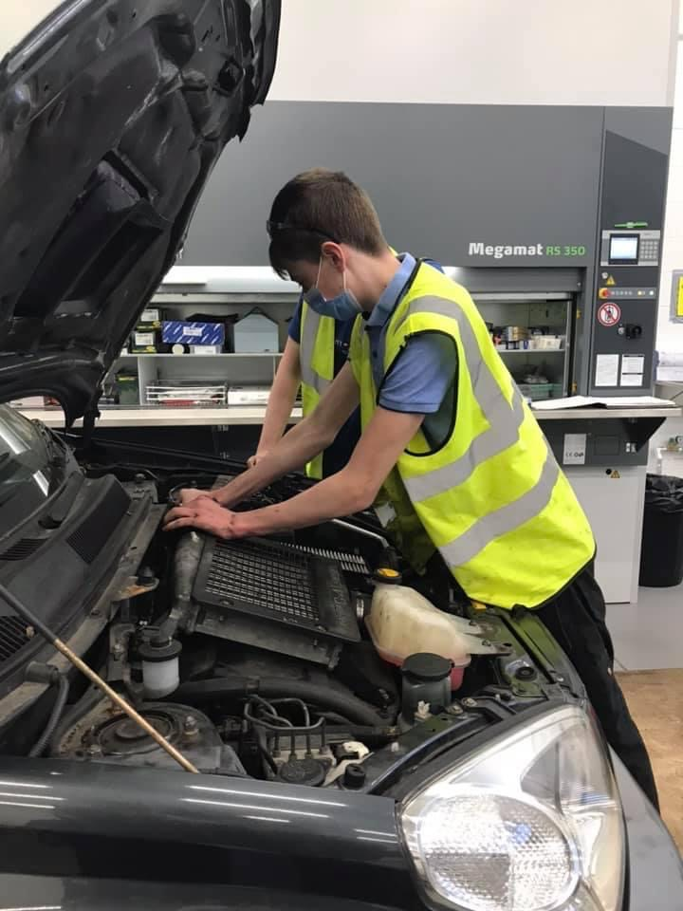
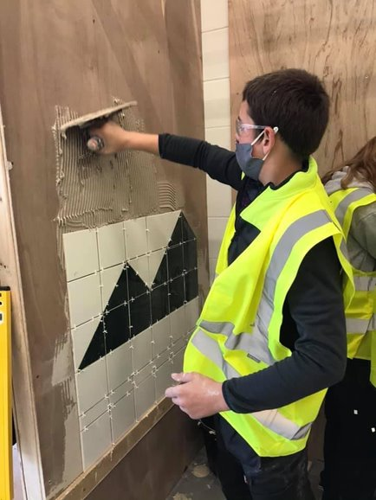
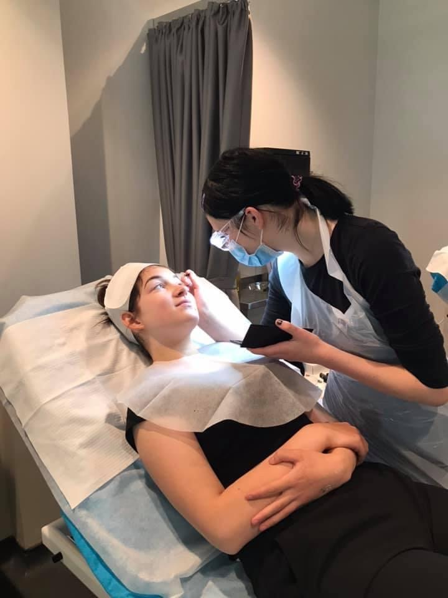
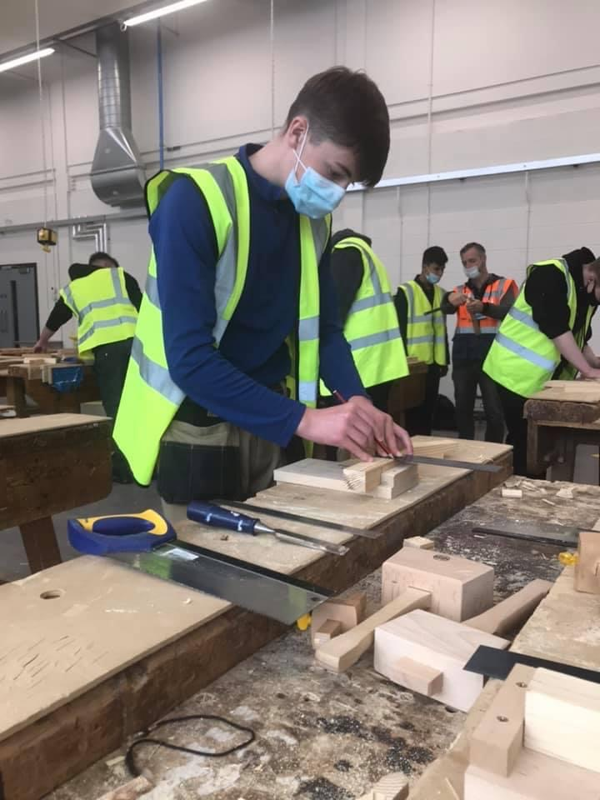
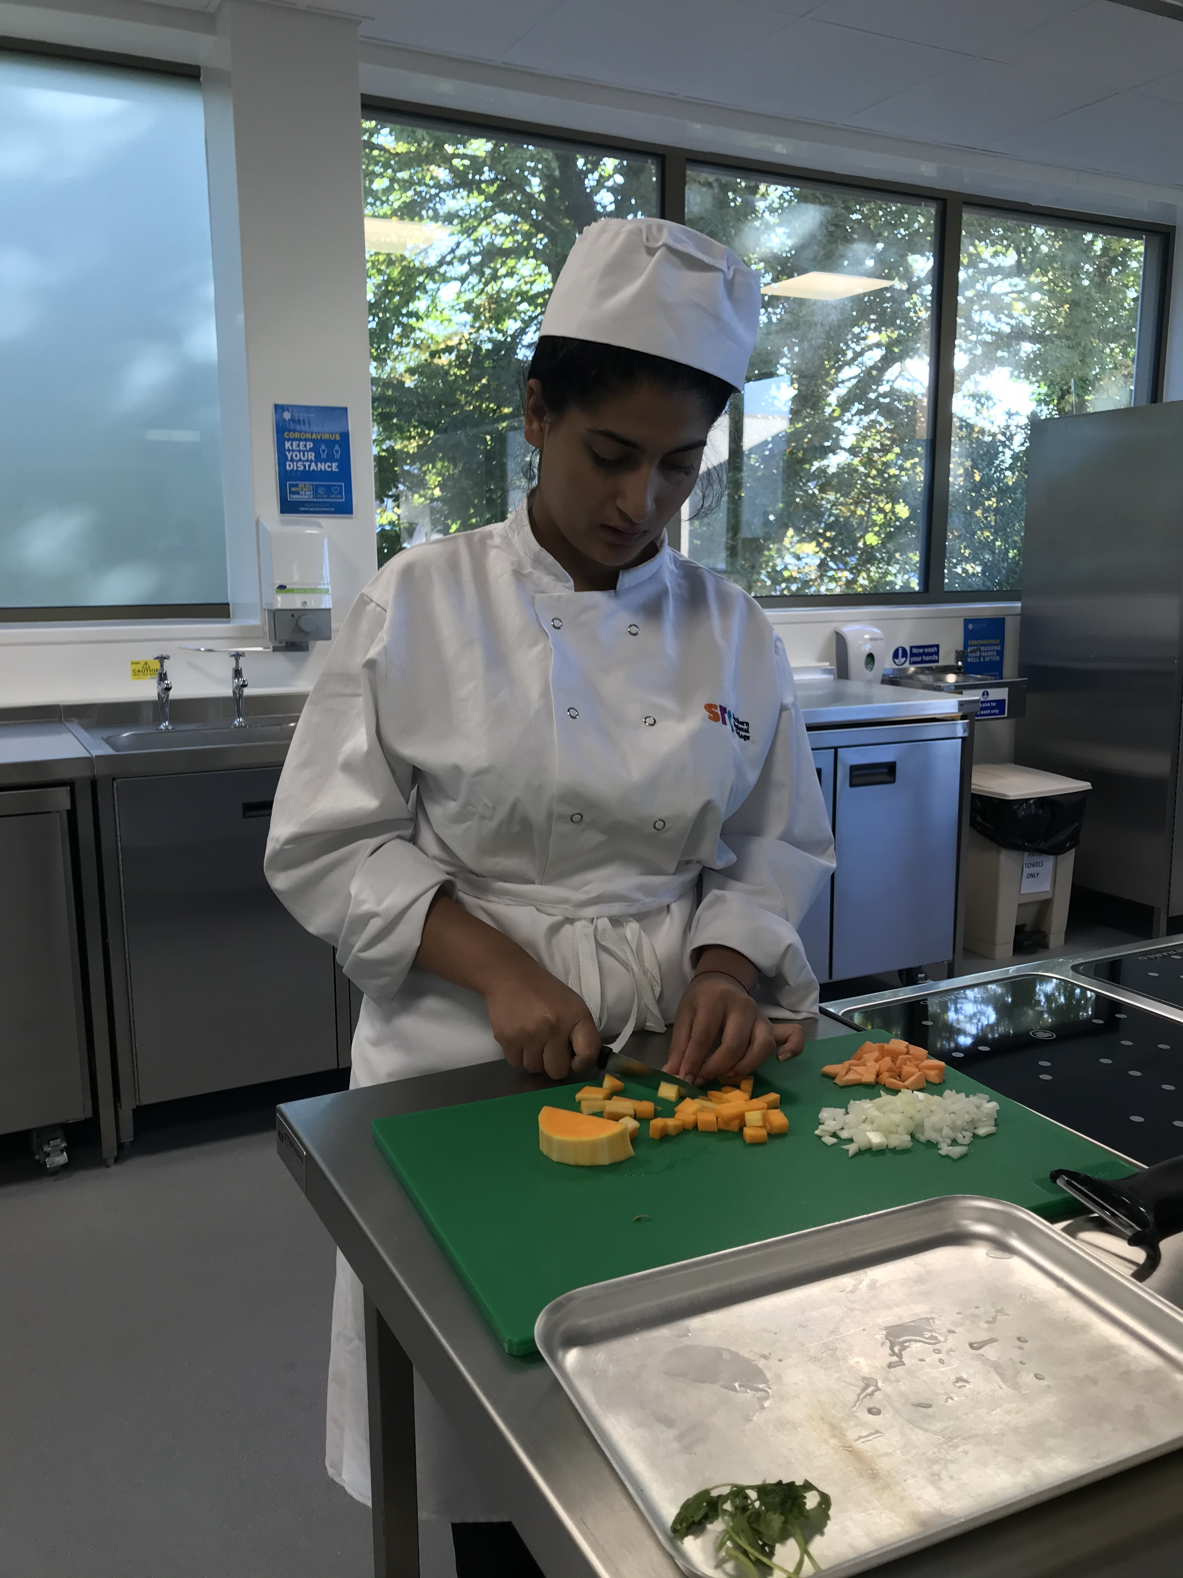
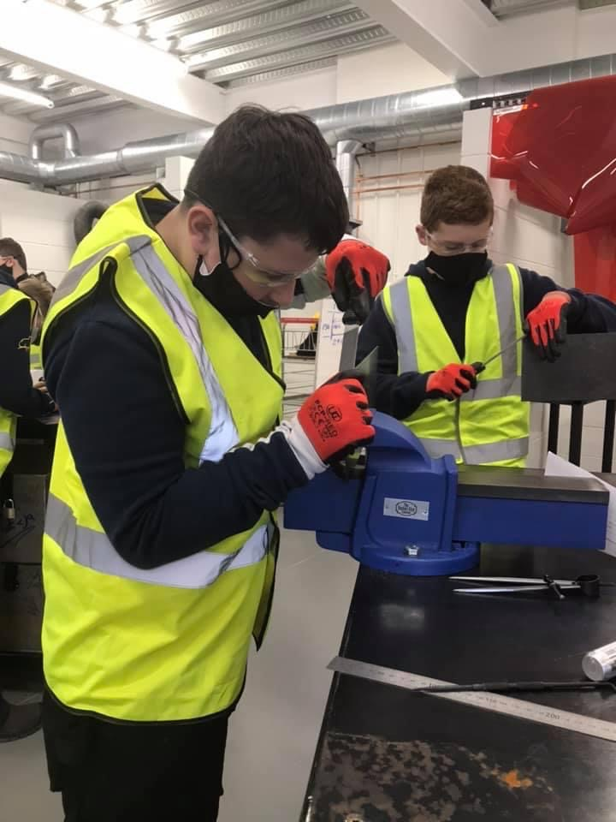
Occupational Studies
Pathways of Study
 | Business and Services |  | Construction |  | Design and Creativity |  | Engineering and Engineering services |  | Environment and Society |  | Technology and Innovation
 | Shampooing and Conditioning Treatments |  | Plumbing |  | Creative Styling using Blow Drying Techniques |  | Electrical Wiring Installation |  | Reminiscence with Individuals in a care setting. |  | Carpentry and Joinery
 | Creative Styling using Blow Drying Techniques |  | Tiling |  | Creating Hair Styling on Long Hair |  | Manufacturing Techniques - Sheet Metal Work |  | Running a Leisure Event |  | Computer Aided Design
 | Facial Skin Care |  | Brick/Blockwork |  | Total Beauty |  | Vehicle Servicing and Valeting Operations |  | Sports Leadership |  | Digital Imaging
 | Manicure and Nail Art |  | Carpentry and Joinery |  | Patisserie and Baking |  | Plumbing |  | Working in a Care Environment |  | Manufacturing Techniques – Sheet Metalwork
 | Patisserie and Baking |  |  |  | Contemporary Cuisine |  | Computer Aided Design
 | Contemporary Cuisine |  |  |  | Website Development |  | Maintenance of Land Based Machinery
 | Vehicle Servicing and Valeting Operations |  |  |  | Graphic Design
This is a 'hands on' course, which allows you to develop your skills in a more practical, occupational environment. You will study at the Southern Regional College one day a week.
There are 6 possible pathways of study and over the 2 years you will study 4 subjects from 2 of the pathways.
Environment
And Society
Construction
Engineering and
Engineering Services
How is my work assessed?
Each subject is marked out of 100
2 subjects combined = 1 GCSE
120/200 = Pass (C)
140/200 = Merit (B)
160/200 = Distinction (A)
180/200 = Distinction * (A*)

Slide 22





BTEC Level 2 (SRC)
As well as Occupational Studies, there is also an option of studying several BTEC Courses on Fridays at the SRC.
BTECS allow you to take a vocational qualification in your chosen area of study. The qualification is designed to equip you with the skills and knowledge to progress to further study.
BTEC Construction
A link to the SRC information leaflet can be found here
BTEC Engineering
A link to the SRC information leaflet can be found here
BTEC Countryside
and the Environment
A link to the SRC information leaflet
can be found here
BTEC Creative Media
A link to the SRC information leaflet can be found here
BTEC Business
A link to the specification can be found here

Slide 23


Personal Success & Well-being
- The Level 2 Certificate in OCN Personal Success and Well-being equates to a Grade B at GCSE
- In order to achieve the Certificate, learners must complete a total of 13 credits over the 2-year course
-Units studied include:
Improving Confidence and Self-Esteem
Personal Motivation
Managing Personal Finances
Personal Improvement Through Sport
Learners complete a portfolio of evidence throughout the course, with a mixture of practical tasks, group discussion and some writing to log, record and evaluate their skills.

Slide 24



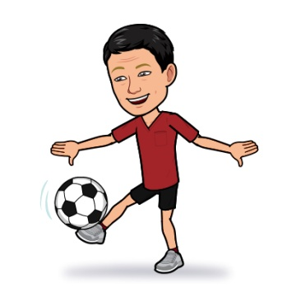


GCSE
Physical Education
50% Theory 50% Practical
Theory: 2 exams 25% each
Practical: 50%
Individual Performance in 3 Physical Activities or Sports.
Exam Paper 1:
Factors Underpinning Health and Performance.
Exam Paper 1:
Developing Performance
Developing Physical Fitness for Performance
Developing Skilled Performance
The Body at work
Health and Lifestyle Decisions
The Active Leisure Industry
A full list of CCEA approved activities can be found here

Slide 25

Prince's Trust:
Level 2 Personal Development and Employability
Approximately 6 units of work are completed. Each pupil creates a portfolio for each, to be assessed through Internal and External Verification.
The focus is on transferable skills that can be used in further education or in the workplace.
For example: Teamwork; Digital Skills or Presentation Skills.
This qualification is equivalent to 2 GCSEs.

Slide 26
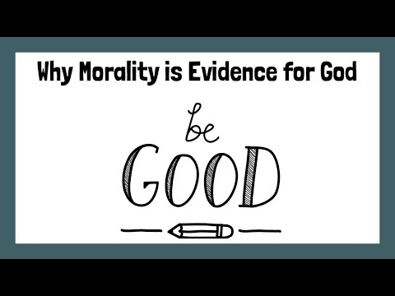
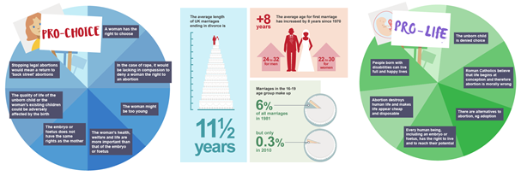
Religious Studies
What will you learn in GCSE RE?
In Year 11 students study Christian Ethics
Year 12 STUDENTS study Philosophy of Religion.
You can get an overview of the topics we study - and GCSE revision videos - by CLICKING this link
GCSE RELIGIOUS STUDIES –CCEA
The subject is assessed in two papers, one taken in year 11 (which can be repeated) and one in year 12.
Click on this link to find out more

Slide 27
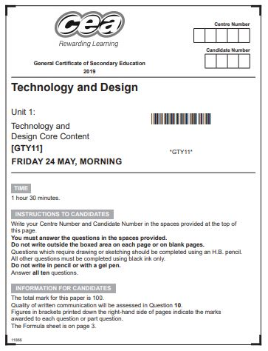
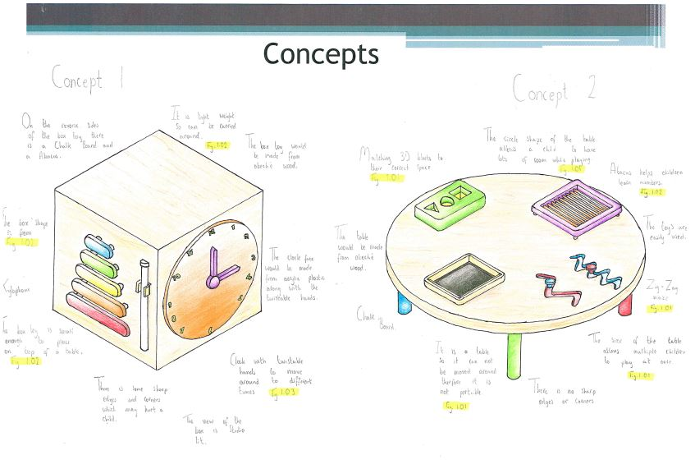

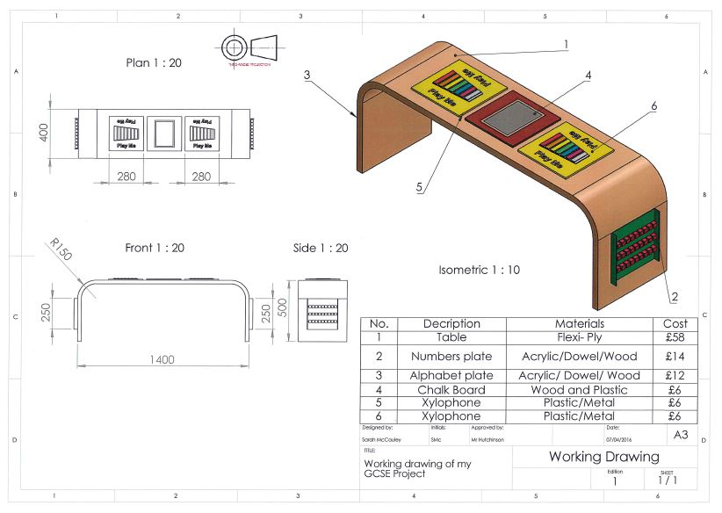
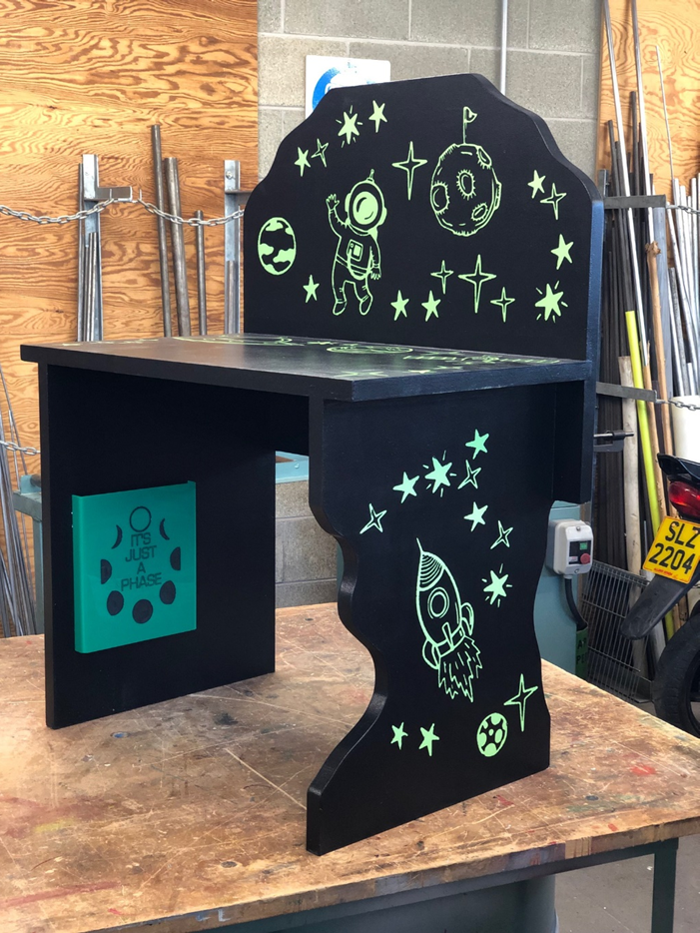
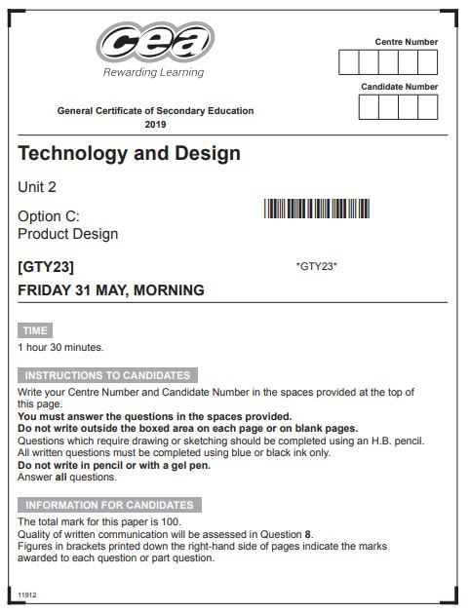
GCSE Technology
& Design
Design Portfolio
25%
Two exams
25% each
Manufactured Product
25%

